Slide 1
Salary Data
Salary Data based on Experience,Age,Gender,Job Title and Education Level

Slide 2
About Dataset
A The dataset was obtained from multiple sources, including surveys, job posting sites, and other publicly available sources.A total of 6704 data points were collected.The dataset included five variables: age, experience, job role, and education level and salary

Slide 3
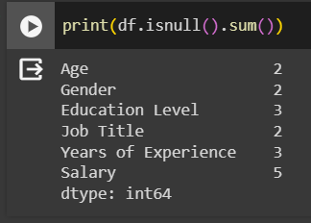
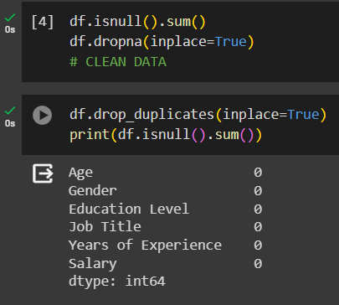
There are null items on the datasets
I was able to remove them on the dataset

Slide 4
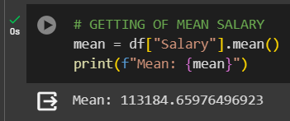
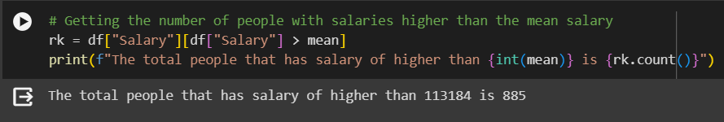
Mean salary and the people with salary that is greater than the mean salary

Slide 5
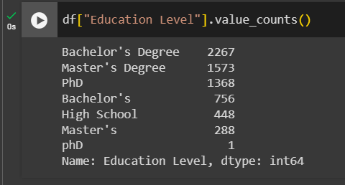
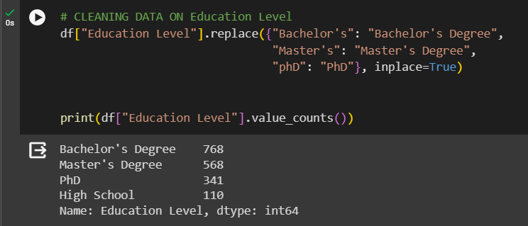
Education Level column is not clean
cleaned the section by replacing values

Slide 6
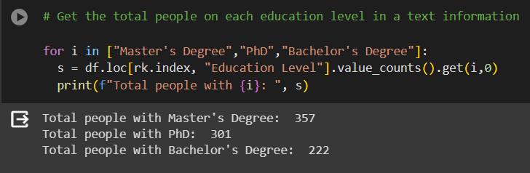
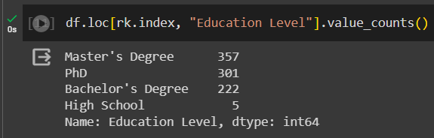
Education level of people whose salary exceed mean salary

Slide 7
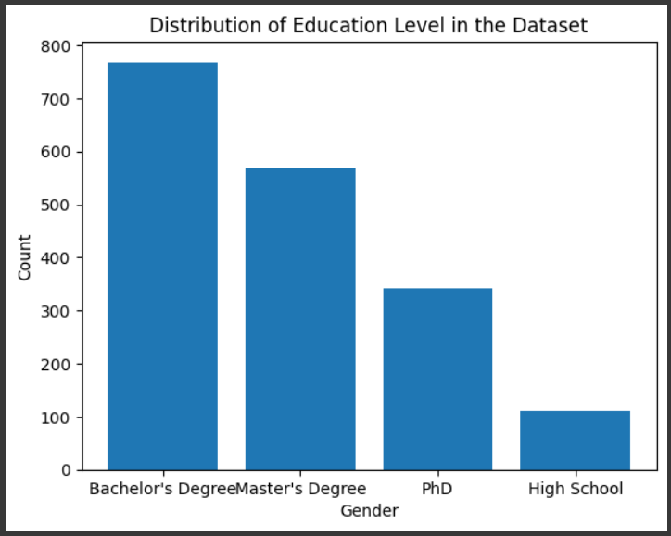
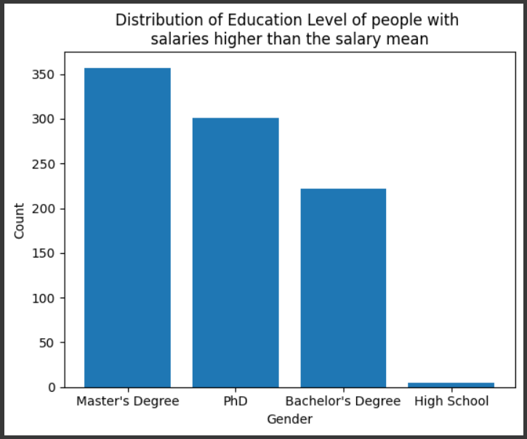
Bar graph for Education level

Slide 8
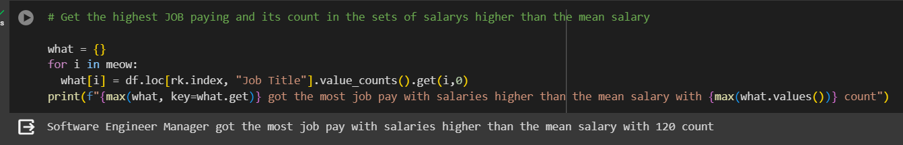
Dominant highest paying job and its count
got Software Engineer manager with a total of 120 counts

Slide 9
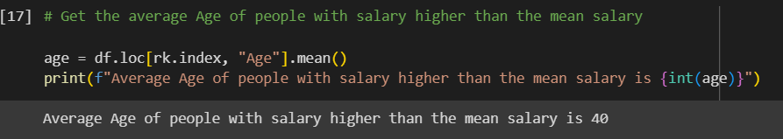
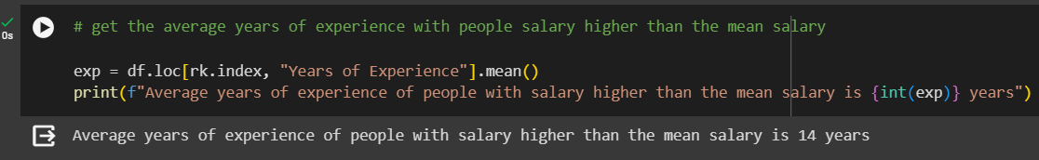
Average Age and years of experience of people who exceed mean salary

Slide 10
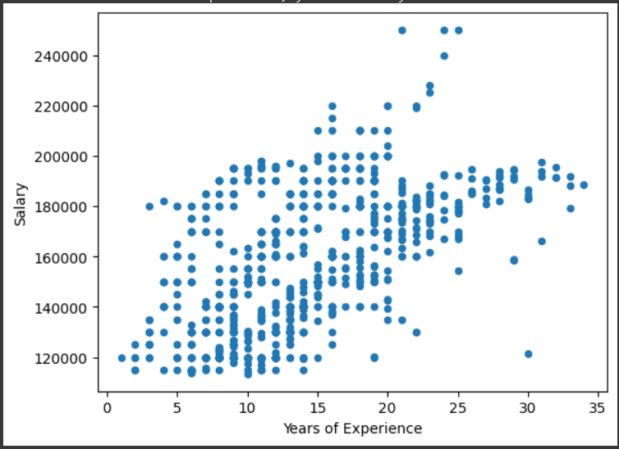
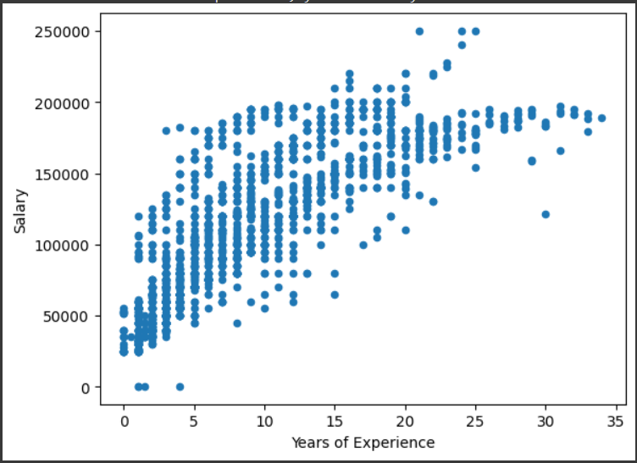
Scatter plot of years of experience and salary of people whose salary exceed the mean salary and people in the data set
People with salary over the mean salary
People in the data set

Slide 11
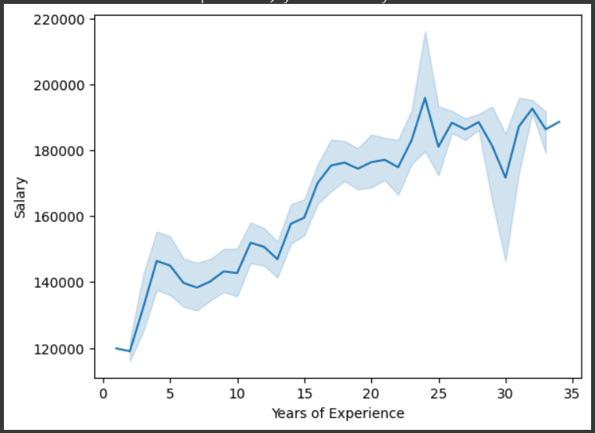
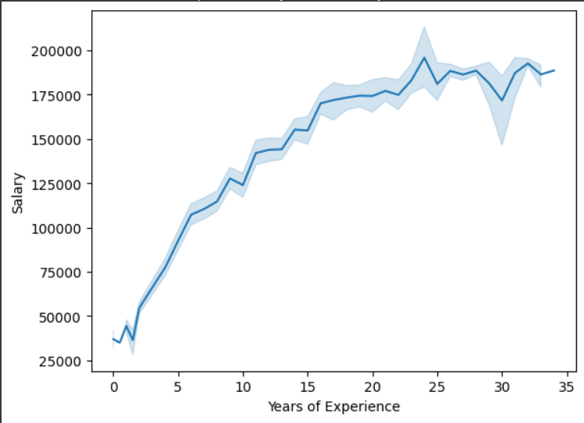
Line plot of years of experience and salary of people whose salary exceed the mean salary and people in the data set
People with salary over the mean salary
People in the data set

Slide 12
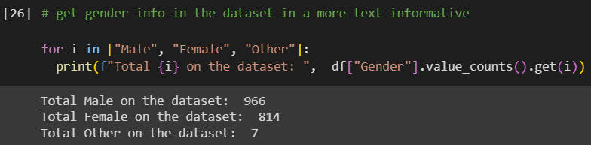
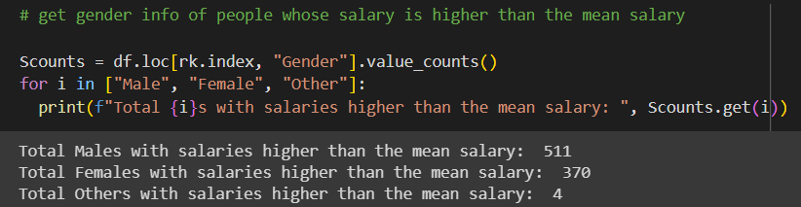
Male and Female counts in the data set
Male and Female counts in the data set whose salary is above the mean salary

Slide 13
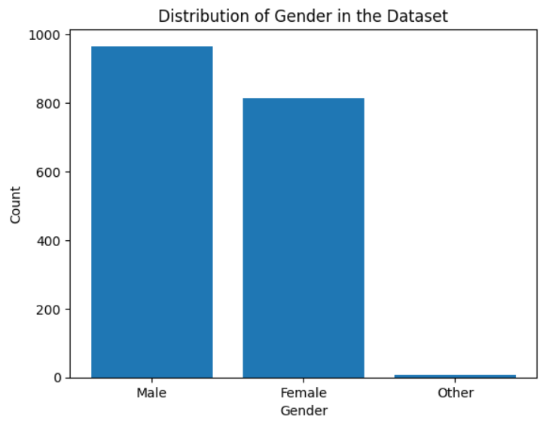
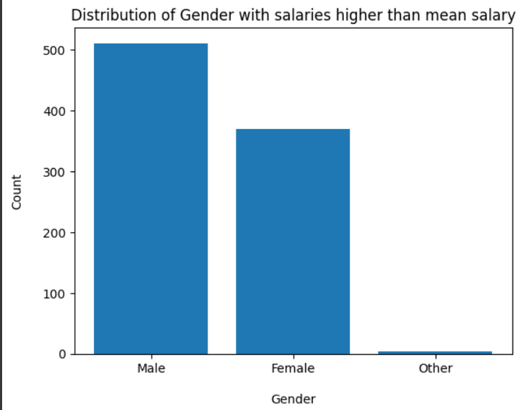
Bar graph of the genders

